Slide 1
DATA SCIENCE
11 WEEK PART TIME COURSE
Week 8 - Cloud Computing
Monday 9th May 2016

Slide 2
AGENDA
Guest Speaker
Cloud Computing
Spark
Lab
Real World Problem
Review

Slide 3
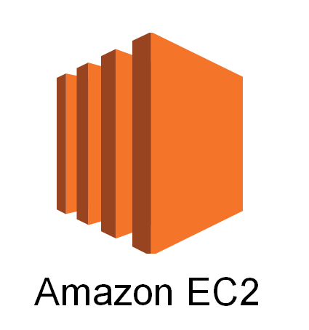



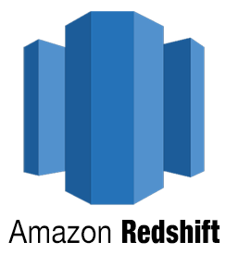
WHAT IS IT AND WHY USE IT?
EC2
RDS
mongoDB
Redshift
Spark

Slide 4
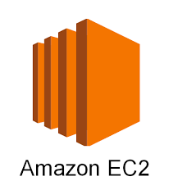



AWS - SPARK - JUPYTER

Slide 5
NO-SQL
DATA SCIENCE PART TIME COURSE

Slide 6
SQL/NoSQL
SQL
Traditional rows and columns data
Strict structure / Primary Keys
Entire column for each feature
Industry standard
NoSQL
No well defined data structure
Works better for unstructured data
Cheaper hardware
Popular among Startups

Slide 7
SQL/NoSQL - Examples
SQL
MySQL
Oracle
Postgres
SQLite
SQLServer
Redshift
NoSQL
MongoDB
CouchDB
Redis
Cassandra
Neo4j
HBase

Slide 8

SQL/NoSQL - Examples
SQL
MySQL
Oracle
Postgres
SQLite
SQLServer
Redshift
NoSQL
MongoDB
CouchDB
Redis
Cassandra
Neo4j
HBase

Slide 9
SPARK
DATA SCIENCE PART TIME COURSE

Slide 10
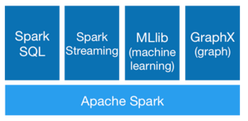
SPARK - WHAT IS IT?
Spark is a fast and general processing engine compatible with Hadoop data. It can process data in HDFS, HBase, Cassandra, Hive, and any Hadoop InputFormat. It is designed to perform both batch processing (similar to MapReduce) and new workloads like streaming, interactive queries, and machine learning.

Slide 11
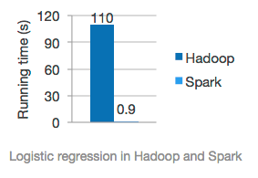
SPARK - HOW DOES IT RELATE TO DATA SCIENCE?
MLlib is Spark’s machine learning library. Its goal is to make practical machine learning scalable and easy. It consists of common learning algorithms and utilities, including classification, regression, clustering, collaborative filtering, dimensionality reduction, as well as lower-level optimization primitives and higher-level pipeline APIs.
GraphX in Spark for graphs and graph-parallel computation

Slide 12
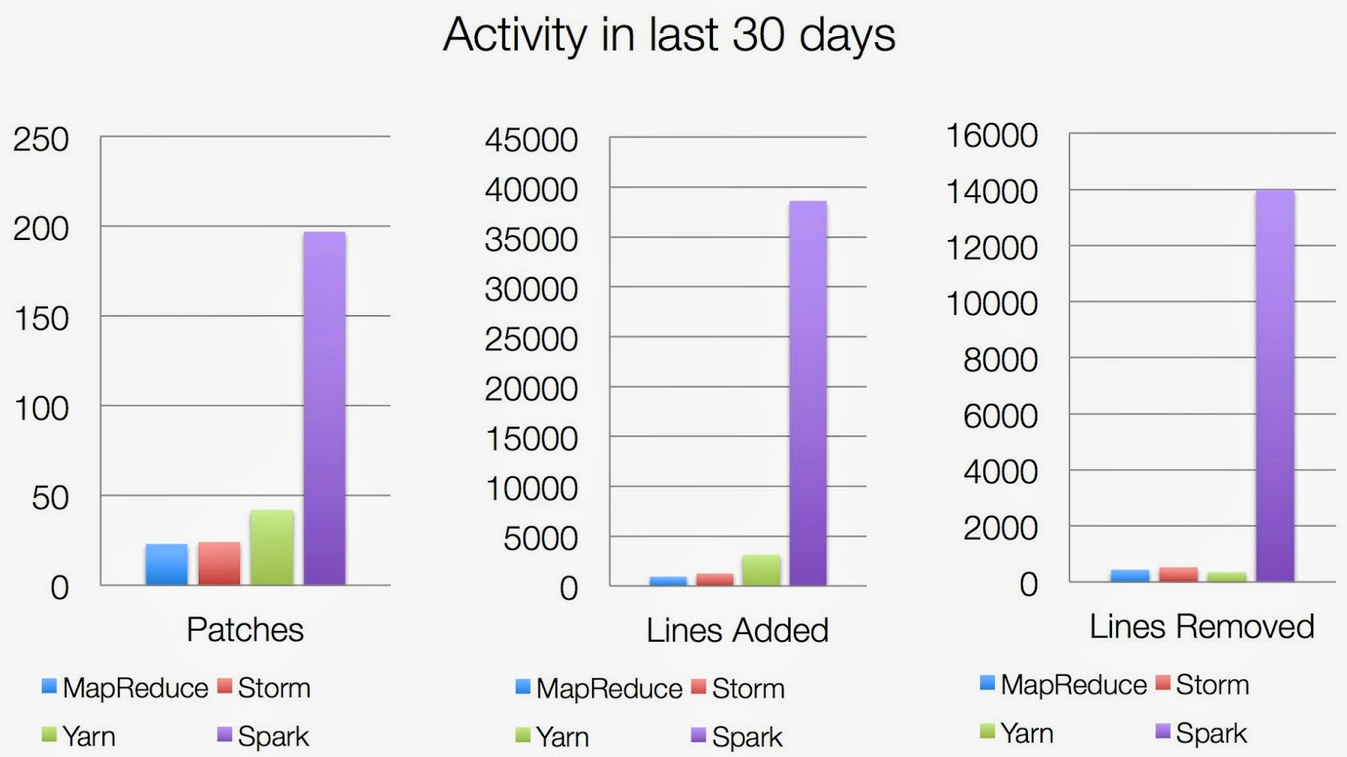
SPARK - HOW POPULAR IS IT?

Slide 13

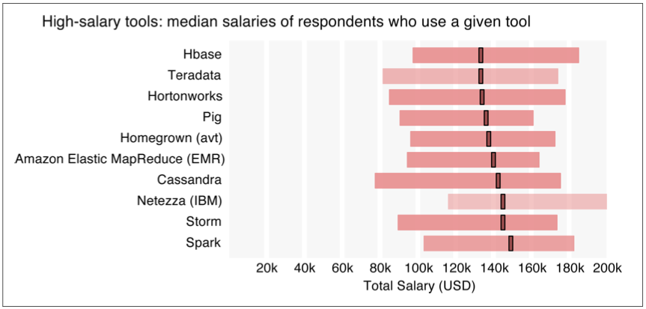
‘We can talk, but money talks, so talk more bucks’ - Jay-Z (Izzo - The Blueprint)

Slide 14
RESILIENT DISTRIBUTED DATASETS (RDDs)
Spark revolves around the concept of a resilient distributed dataset (RDD), which is a fault-tolerant collection of elements that can be operated on in parallel.
There are two ways to create RDDs:
Parallelizing an existing collection in your driver program
Referencing a dataset in an external storage system, such as a shared filesystem, HDFS, HBase, or any data source offering a Hadoop InputFormat

Slide 15
SPARK SQL
One use of Spark SQL is to execute SQL queries written using either a basic SQL syntax or HiveQL. Spark SQL can also be used to read data from an existing Hive installation.
Spark SQL provide Spark with more information about the structure of both the data and the computation being performed. Internally, Spark SQL uses this extra information to perform extra optimizations. There are several ways to interact with Spark SQL including SQL, the DataFrames API and the Datasets API. When computing a result the same execution engine is used, independent of which API/language you are using to express the computation.

Slide 16
SPARK DATAFRAMES
A DataFrame is a distributed collection of data organized into named columns.
It is conceptually equivalent to a table in a relational database or a data frame in R/Python, but with richer optimizations under the hood.
DataFrames can be constructed from a wide array of sources such as: structured data files, tables in Hive, external databases, or existing RDDs.

Slide 17
SPARK DATASETS
A Dataset is a new experimental interface added in Spark 1.6 that tries to provide the benefits of RDDs (strong typing, ability to use powerful lambda functions) with the benefits of Spark SQL’s optimized execution engine.
A Dataset can be constructed from JVM objects and then manipulated using functional transformations (map, flatMap, filter, etc.).
The unified Dataset API can be used both in Scala and Java. Python does not yet have support for the Dataset API. Full python support will be added in a future release.

Slide 18
SPARK MLLIB & SPARK ML
spark.mllib contains the original API built on top of RDDs.
spark.ml provides higher-level API built on top of DataFrames for constructing ML pipelines.

Slide 19
SPARK MLLIB
Data types
Basic statistics
summary statistics
correlations
stratified sampling
hypothesis testing
streaming significance testing
random data generation
Classification and regression
linear models (SVMs, logistic regression, linear regression)
naive Bayes
decision trees
ensembles of trees (Random Forests and Gradient-Boosted Trees)
isotonic regression
Collaborative filtering
alternating least squares (ALS)
Clustering
k-means
Gaussian mixture
power iteration clustering (PIC)
latent Dirichlet allocation (LDA)
bisecting k-means
streaming k-means
Dimensionality reduction
singular value decomposition (SVD)
principal component analysis (PCA)
Feature extraction and transformation
Frequent pattern mining
FP-growth
association rules
PrefixSpan
Evaluation metrics
PMML model export
Optimization (developer)

Slide 20

Pipelines

Slide 21
PIPELINES
Two types of pipelines
Transformer - takes a dataset as input and produces an augmented dataset as output. For example, a transformer may read a column (e.g., text), map it into a new column (e.g., feature vectors), and output a new DataFrame with the mapped column appended
Estimator - basically training a model, it must be first fit on the input dataset to produce a model. For example, a learning algorithm such as LogisticRegression is an Estimator.

Slide 22
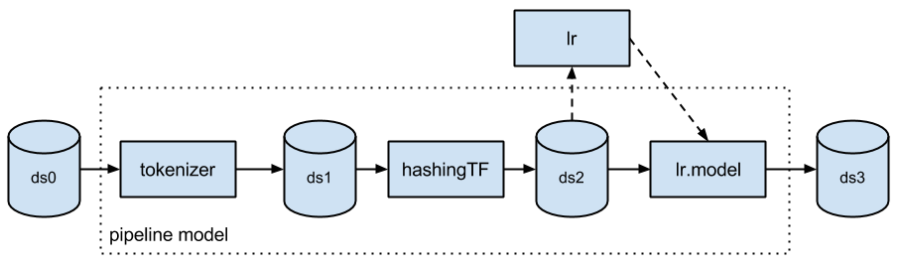
PIPELINES

Slide 23
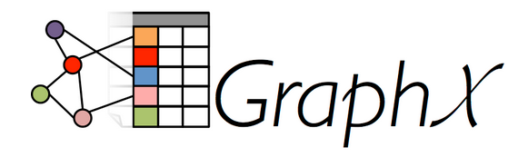
SPARK GRAPHX
Useful for graphs and graph parallel processing
PageRank
Label Propagation
SVD++
Triangle Counting

Slide 24
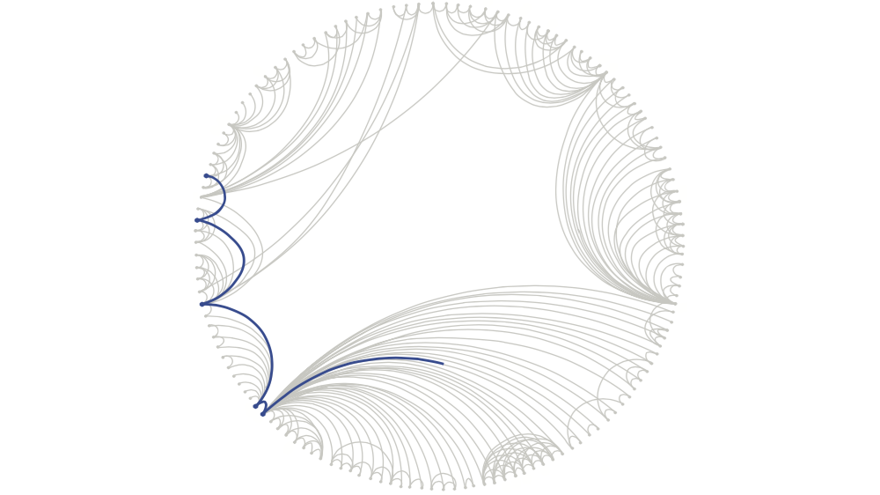
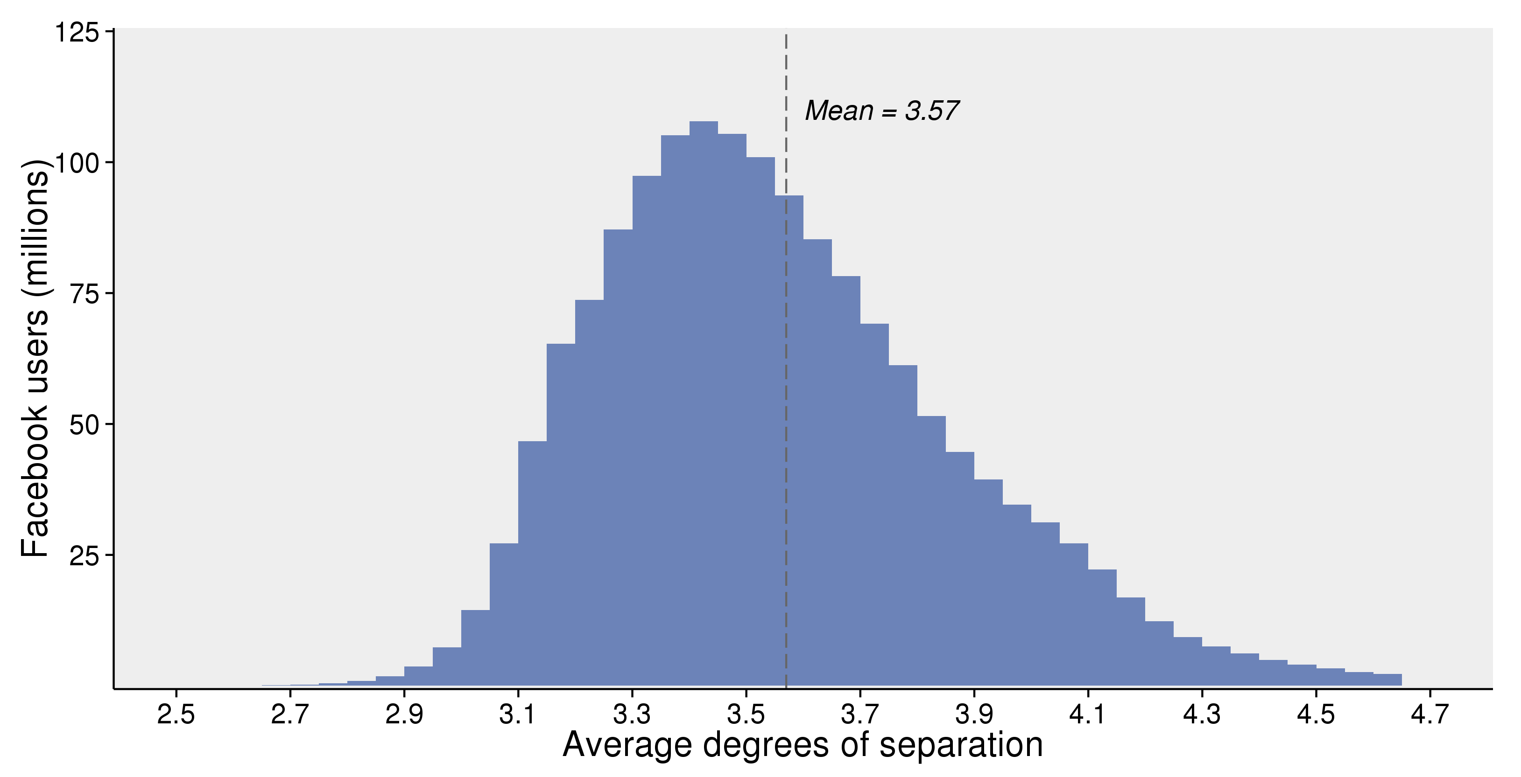
DIGRESSION - GRAPH ANALYSIS - FACEBOOK
How connected is the world?
Each person in the world (at least among the 1.59 billion people active on Facebook) is connected to every other person by an average of three and a half other people.
Rather than calculate it exactly, they estimate distances with statistical algorithms

Slide 25
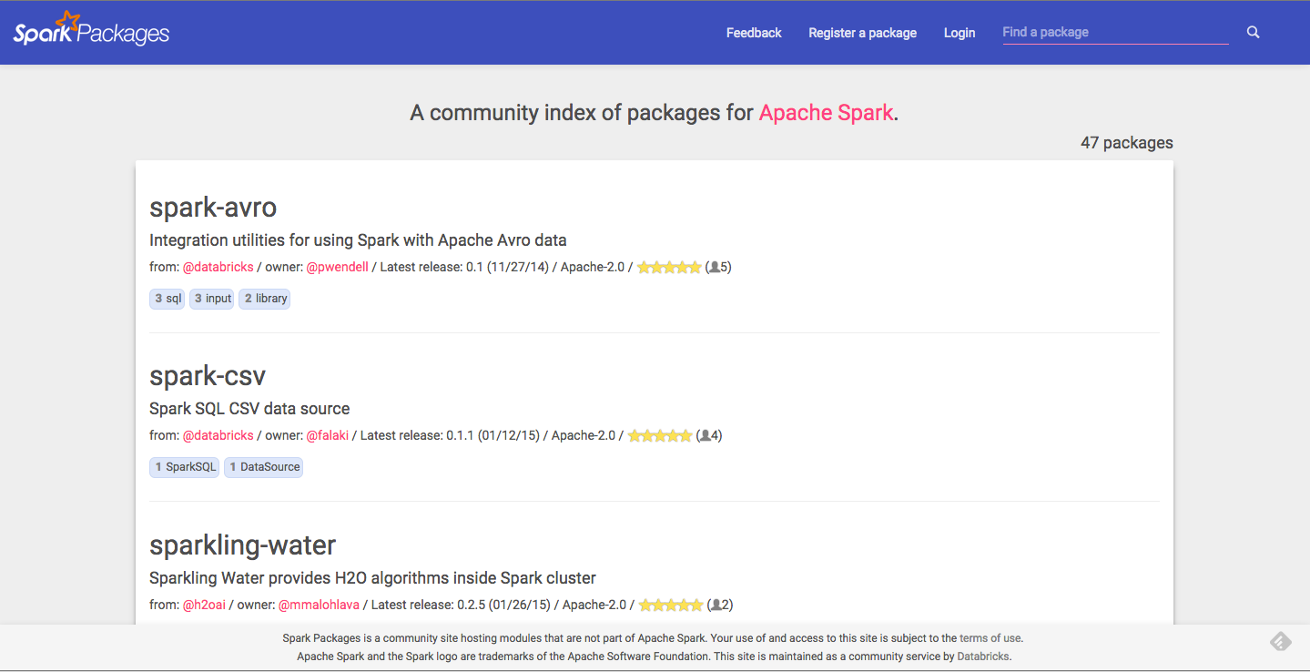
SPARK PACKAGES

Slide 26

LAB
DATA SCIENCE PART TIME COURSE

Slide 27

DATA SCIENCE PART TIME COURSE

Slide 28
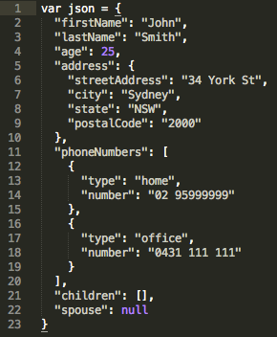
JSON - WHAT IS IT?
JSON - JavaScript Object Notation
Human readable data with attribute-value pairs.
What is inside the curly brackets is an object
In the object we declare variables with ‘attribute’ : ‘value’ pairs

Slide 29
JSON - HOW DOES IT RELATE TO DATA SCIENCE?
Webservices provide application programming interfaces (APIs) are now usually transferring data via JSON
Underlying document databases like MongoDB
Increasingly common data format

Slide 30

DATA SCIENCE PART TIME COURSE

Slide 31
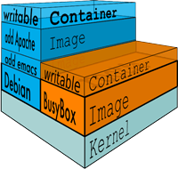
DOCKER - WHAT IS IT?
Docker containers wrap up a piece of software in a complete filesystem that contains everything it needs to run: code, runtime, system tools, system libraries – anything you can install on a server. This guarantees that it will always run the same, regardless of the environment it is running in.
Lightweight
Open
Secure

Slide 32
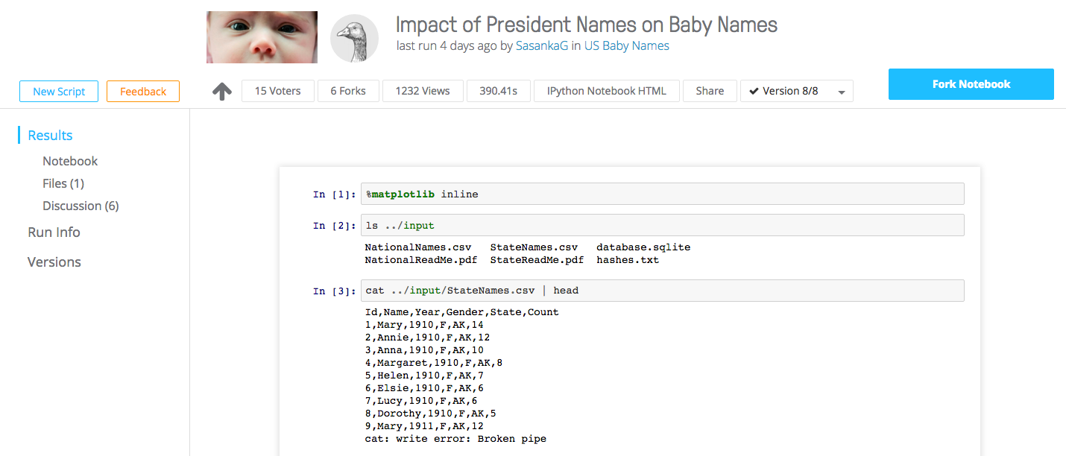
DOCKER - HOW DOES IT RELATE TO DATA SCIENCE?
Installing data science software can be a pain because of software dependencies and different OS environments. Docker helps solve this problem
See Kaggle Scripts

Slide 33
LAB
Start a Spark cluster with EMR
Run a notebook in Zepplin and connect to it
Load and analyse data in Spark
DATA SCIENCE - Week 8 Day 1

Slide 34
DISCUSSION TIME
Talk through a real problem
Review last week
Questions
Task List
DATA SCIENCE - Week 8 Day 1

Slide 35



REAL PROBLEMS
DATA SCIENCE - Week 8 Day 1

Slide 36
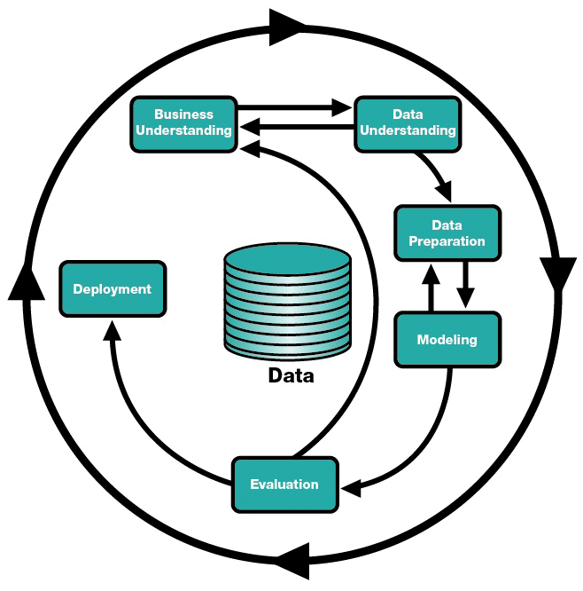
DATA SCIENCE - Week 8 Day 1

Slide 37
REVIEW
DATA SCIENCE - Week 8

Slide 38
Task List (25 mins)
Read Natural Language Processing website - http://www.nltk.org/ (5 mins)
Read and be able to explain one use case of the Alchemy API (10 mins)
Download and install NLTK for Python (10mins)
DATA SCIENCE - Week 8 Day 1

